Slide 1
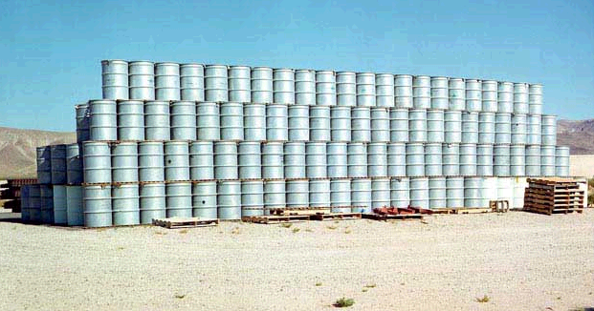
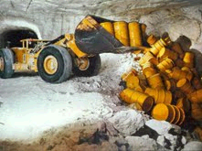
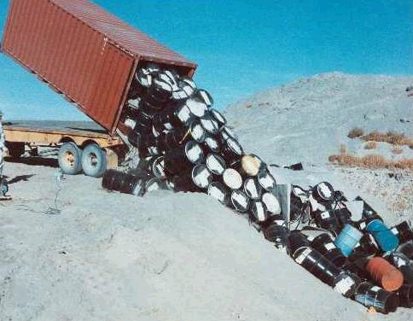
Expert Hearing: Nuclear Waste- Will the Directive solve the problem? 8th June 2010
Anni Podimata,
Vice President ITRE

Slide 2
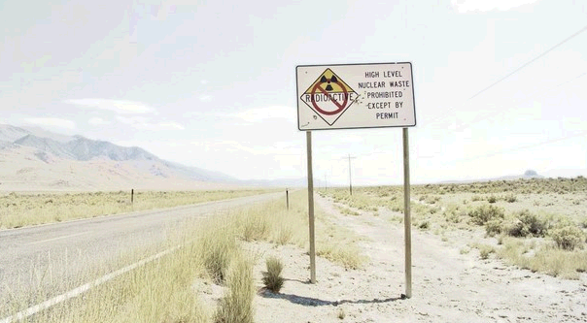
Current state of play
At present, 15 out of 27 EU States have nuclear power plants, but there are only a few projects for final repositories for the most hazardous radioactive waste category.
Energy from nuclear fission currently represents around 14.6% of the primary energy consumed in the European Union and 31% of the electricity generated.
While many EU countries are planning for life extensions on existing plans, several countries in Eastern Europe are currently constructing (Romania and Slovakia) or have firm plans to build new nuclear power plants (Bulgaria, Czech Republic, Romania, Slovenia and Turkey).
Is this a nuclear revival?
Is Europe ready for this?

Slide 3
Nuclear Energy : an energy source or an environmental- social risk?
Nuclear Energy is considered by many as the “sustainable” answer to crucial issues:
security of energy supply
reduction of GHG emissions
increasing energy demand
climate change
…but can it really be the right answer taking into account :
nuclear waste production
limited uranium supply (30 -60 years)
high costs
technically impossible to build a 100% safe plan
Nuclear Energy contradicts with the idea of sustainability if future generations have to deal with dangerous waste generated from preceding generations.

Slide 4
Eurobarometer Survey
an overall majority of 82% European citizens say nuclear waste management should be regulated at EU level, according to the Special Eurobarometer survey "Europeans and Nuclear Safety".
half of Europeans consider nuclear energy more as a risk (50%) while more than a third (36%) see this energy source as beneficial to them and their families.
the highest risks to nuclear safety are considered to be lack of security in NPPs against terrorist attacks, the misuse of radioactive materials and the disposal of radioactive waste. 52% of Europeans disagree with the view that nuclear power plants are sufficiently secured against terrorist attacks, 49% do not consider that the disposal of radioactive waste can be carried out safely and 45% disagree that “Nuclear materials are sufficiently protected against malevolent use”.

Slide 5
From a general perspective, disagreement with the statement that nuclear energy helps to limit climate change is higher than three years ago: in Luxembourg (48%) and Latvia (44%) a comparative majority disagree with this statement. Opposition clearly outweighs agreement in Greece (50%) and especially in Austria, where almost two out of three citizens do not believe nuclear energy helps to fight climate change (63%).

Slide 6
EU Nuclear Waste Directive is under way
although the energy mix is a national competence, the EU is engaged in creating the most advanced EU legal framework for nuclear safety, security and the management of radioactive waste
the existing Community legislation dealing with spent fuel and radioactive waste covers only a small range of the issues involved in their management, such as the supervision and control of shipments of radioactive waste
in an attempt to fill this gap, in autumn, the Commission is going to present a proposal for a nuclear waste directive to create common rules for nuclear waste storage in the EU
the public consultation on the legislative proposal has finished on the 31st of May and a transparent assessment of the results is needed that reflects the public opinion

Slide 7
Some questions on the forthcoming EU Legislative
Can we have a legally binding EU Instrument that applies to all types of radioactive waste and covers all stages from generation to final disposal?
The idea of shared repositories can be an answer to the waste management problem? What about the political and social acceptance on disposal solutions?
Can we guarantee transparency regarding the repositories? e.g. Italian mafia implicated in radioactive waste dumping off coast
Can non-EU countries be committed to implement the most advanced safety standards and best nuclear waste management practices?
What about moral issues, such as transboundary dumping of nuclear waste to developing nations?

Slide 8
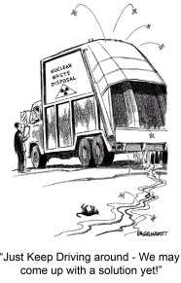
food for thought…
A number of European power plants are currently nearing the end of their lifespan and they will need to be decommissioned safely and re-evaluate their use in the future
The implementation of geological disposal requires long-term political commitment, modern governance concepts, building on a step-by-step approach and early involvement of national and local stakeholders to ensure sound consultations and acceptance
“Nuclear accidents may occur more often as atomic technology spreads and countries build more reactors”, “Member states are considering the introduction of nuclear power plants. We cannot exclude accidents. If there are more, we have certain risks.” Yukiva Amano, International Atomic Energy Agency Director General

Slide 9
Thank you for your attention!
anni.podimata@europarl.europa.eu

